Slide 1
Chemical Energy Storage “Super Plant” Storage
KAMALAKUMAR Arruran
Levi Topaz
Omar al saedyyn
Royee Bustan

Slide 2
What is “Super Plant”?
“Super Plant” generates glucose more than it needs for its respiration.
How and Why ?
Grown in the sea
Genetically engineered Algae
Black Algae
Enzymes that makes photosynthesis run faster

Slide 3
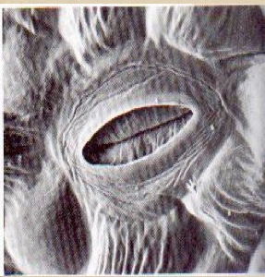
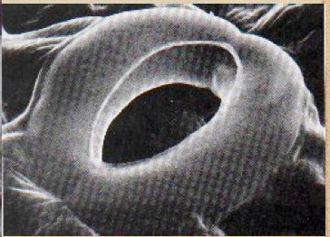
If the temperature will get too high the super plant will stop the photosynthesis by closing the stoma
Closed stoma
Open stoma

Slide 4
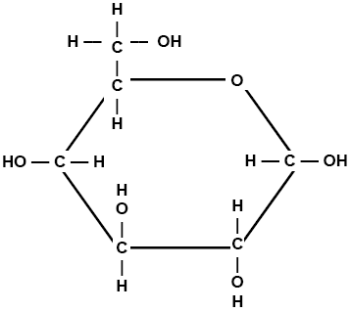
Profit gained by Super Plant
Energy storage in the form of glucose
Oxygen (O2)
Glucose molecule

Slide 5
Growing Super plants on sea surface
Photosynthesis by super plants
Producing large amounts of glucose
Harvesting the super plants and storing it for later use as an energy source
Growing new super plant (Algae)

Slide 6
But how can we produce energy out of a glucose?!

Slide 7
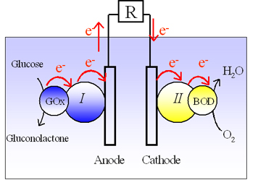
How do we produce energy from glucose?
Researchers at the research center of Paul Pascal developed a mechanism that generates electricity from glucose and oxygen.

Slide 8
The profit of the machine
The research discovered that the machine generates 9 W per cm² when implanted in a cactus.
The super plant produce more glucose than a cactus.
We use a bigger machine together with large amounts of glucose and oxygen
in order to produce more
electricity .

Slide 9
Conclusions:
Growing super plants
Producing glucose
Storing glucose
Making electricity out of the glucose

Slide 10
Questions?

Slide 11
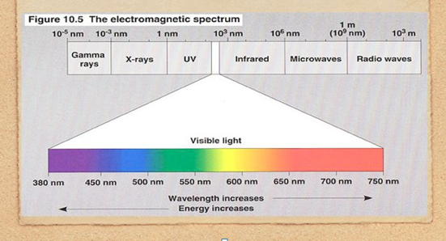

Slide 12
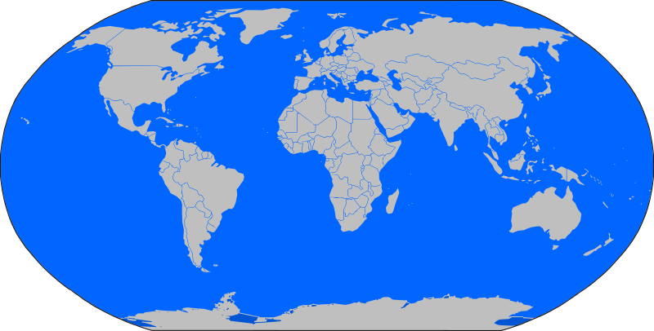

Slide 13
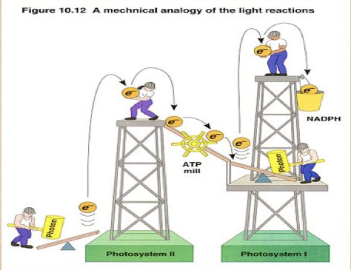

Slide 14
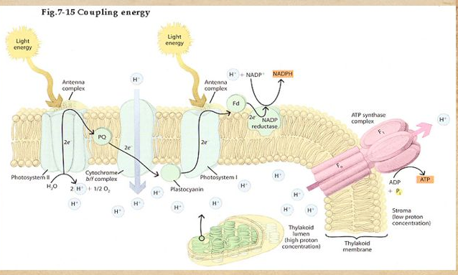
We use acid as a source
hydrogen

