Slide 1
Pumped-storage hydroelectricity
By:
Dana Nissan
Talal Ashqar
Gerrit Kottke

Slide 2
The Problem !
Basic load power stations are working 24 hours a day, cant they stop generating electricity at off-peak time and generate more electricity at peak time ?
Apparently not, the process of “shutting down” the power stations is taking too much time, and stations are continuing to generate electricity all day long (peak / off-peak time), does this means that the electricity generated at off-peak time is just lost ?
Unfortunately yes, isn’t there a solution for this problem ?
why don’t we think is an economical method for storing that lost energy?

Slide 3
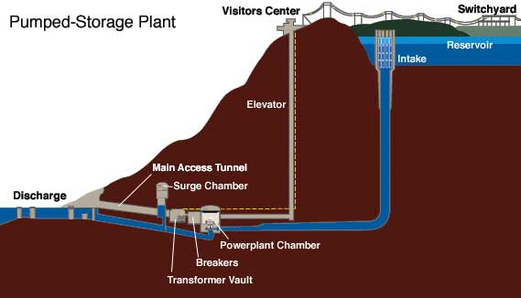
Solution !
Pumped-storage hydroelectricity
Storing energy during off-peak time
Producing electricity at peak time

Slide 4
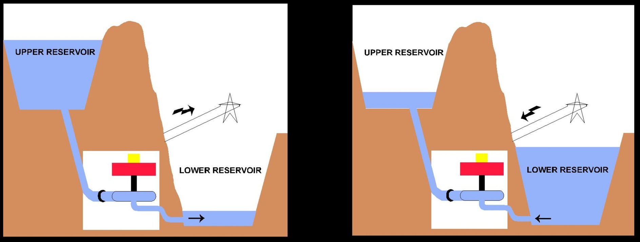
How does it work ?
Storing energy in the form of water.
Low-cast off-peak electricity is used to run the pumps.
At high electrical demand.

Slide 5
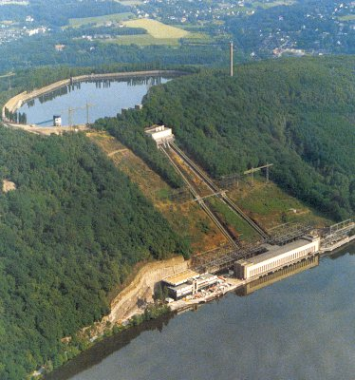
Low density → large body of water / large variation In heat
→ Using the geography (hills and lakes)

Slide 6
Although the losses of the pumping process makes the plant a net consumer of energy overall, the system increases revenue by selling more electricity during periods of peak demand.
Pumped storage is the largest capacity form of grid energy storage now available.

Slide 7
Advantages…
Along with energy management, pumped storage systems help control electrical network frequency and provide reserve generation. Thermal plants are much less able to respond to sudden changes in electrical demand, potentially causing frequency and voltage instability. Pumped storage plants, like other hydroelectric plants, can respond to load changes within seconds.
And also we can say that:
1) low decay rate (depending on the climate)
2) ability of storing a high amount of energy.
3)Low cost per capacity.

Slide 8
Problems we may face..!
In term of consumption of electric power the loss is in range of 25-30% which makes it a very inefficient.
A big amount of loss of water occurs in summer due to evaporation.
Impact on nature:
- Sound pollution
- Forest-life changes
- Hydrology of lake

Slide 9
Method | Max power (Mw) | Durability (times it can be used) | Efficiency | Energy loses (per H) | Max cost (€ per kWh) | Energy density (kWh per ton) | Typical discharge time
Pumped storage | 1,060 | ? | 80.00% | ~ 0 | 71 | 0.4 | 8 hours
Capacitor | 0.01 | 100 million | 95.00% | 0.01% | 200,000 | 0.03 | 0.01 sec
EDLC (capacitor) | 0.1 | 0.5 million | 90.00% | 0.2% | 10,00 | 5 | 100 sec
Superconducting coil | 7 | 1 million | 90.00% | ? | 30-2,000 | 0.03 | 0.01 sec
Carbon fiber flywheel | 50 | 1 million | 95.00% | 0.1-10% | 1,200 | 50 | 100 sec
Accumulator (chemical storage) | 27 | < 1,000 | 80.00% | 0.01% | 100 | 30-120 | 4 hours
Liquid hydrogen | 0.2 | 30,000 H (fuel cell) | 18.20% | 0.1% | ? | 33,300 | 0.5 hours

Slide 10
Problems we may face..!
In term of consumption of electric power the loss is in range of 25-30% which makes it a very inefficient.
A big amount of loss of water occurs in summer due to evaporation.
Impact on nature.
- Sound pollution
- forest-life changes
- hydrology of lake

Slide 12
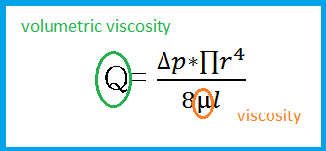
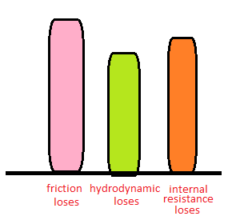
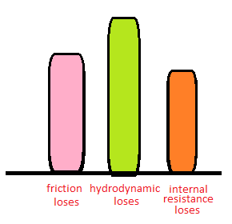
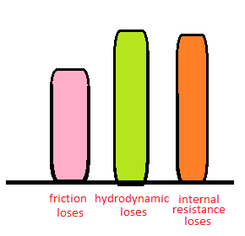
[m^3/s]

Slide 13
Problems we may face..!
In term of consumption of electric power the loss is in range of 25-30% which makes it a very inefficient.
A big amount of loss of water occurs in summer due to evaporation.
Impact on nature.
- Sound pollution
- forest-life changes
- hydrology of lake

Slide 20
Future Of Pumped-Storage Hydroelectricity..?
The future of Renewable-Energy.
Saving the earth.
Saving our money.
Saving energy.
Future built and based on Renewable-Energy,
Differences between the methods that are used to store Renewable-Energy,
We are looking for the method that got the lest disadvantages.
And for us…

Slide 21
Thanks For Your Attention !
Questions ?

