Slide 1
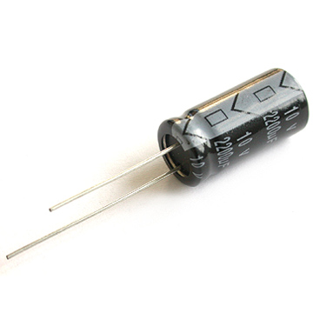
Supercapacitors
Rasa Giniunaite
Niv Minkov
Dotan Berger
Google.com

Slide 2
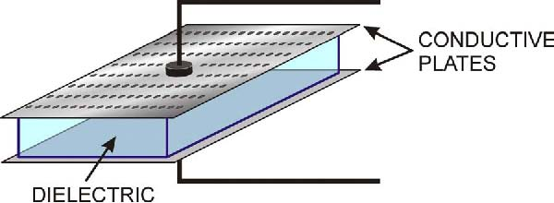
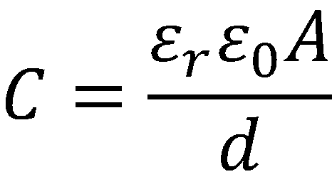
Capacitor
A capacitor stores energy. It is built from two conductive plates and a dielectric material between them.
http://www.veriteq.com/download/Methods-of-Accurately-Measuring-Capacitive-RH-Sensors.htm
Notes:
Explain how does a capacitor works, what effects on the capacitive and formulas.

Slide 3
capacitors in comparison with batteries
Capacitor / Battery Comparison
Device | Energy density Wh/L | Power density W/L | Cycle life Cycles | Discharge time Seconds
Batteries | 50-250 | 150 | 1 - 10³ | > 1000
Capacitors | 0.05 - 5 | 10⁵ - 10⁸ | 10⁵ - 10⁶ | <1
http://www.mpoweruk.com/alternatives.htm
Efficiency is almost 100 %
Don’t fall asleep yet!

Slide 4
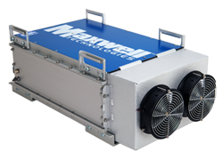
The uses today
Capacitors are in use with almost in every electronic device (regulating voltage, filtering mainly)
Ultra-capacitors: many packs connected in series can be in use in public transportation.
http://maxwell.com/products/ultracapacitors/product.aspx?PID=125V-TRAN-MODULES
Notes:
http://maxwell.com/products/ultracapacitors/product.aspx?PID=125V-TRAN-MODULES

Slide 5
The problem
Coal, oil and natural gas are running out of stock.
Resource | Estimated consumption 2010 | Year of exhaustion
Fossil fuels | 171.68 | 2050
Coal | 148.09 | 2138
Natural gas | 120.95 | 2067
The usage of coal and fossil fuels pollute the air, especially by cars and power stations around the globe.
Ultra capacitors may be the solution to operate public transportation such as trains, buses and more.

Slide 6
Concrete Example
Normal gas operated train has energy consumption of 16.5 kWh/Train-Km
That means 59.4 MJ per km
The train line between Beer Sheva and Tel Aviv is 100km, it is an 80- minute ride.
The entire energy consumption for this ride is 1.2MWh.

Slide 7
Our Proposed Solution: “The C-train”
We chose an existing technology of ultracapacitors. 125V, 63F.
A train needs 5.94x10⁷ J to drive 1 km.
We decided to use one thousand units which can provide enough energy to drive about 8 km
total number of about 13 charging areas will be needed, NO STOP NEEDED TO BE CHARGED
The distance needed to charge a train while driving is proportional to it’s speed.
Notes:
From beer sheva to tel aviv it takes 8.9 GJ

Slide 8
Length vs Speed

Slide 9
Thanks for listening
Have a great evening
I have a feeling, that tonight go’nna be a good night

